Slide 1
4COSCO11C.2 Web Design and Development
Scalable Vector Graphics - SVG
Janani Harischandra

Slide 2
What is SVG?
SVG stands for Scalable Vector Graphics (SVG)
SVG is used to define vector-based graphics for the Web
SVG defines the graphics in XML format
SVG graphics do NOT lose any quality if they are zoomed or resized
Every element and every attribute in SVG files can be animated
SVG is a W3C recommendation
SVG integrates with other W3C standards such as the DOM and XSL
Notes:
As usual with vector graphics, color values and forms are not defined by pixels, but are mathematically described.

Slide 3
SVG Advantages
SVG images can be created and edited with any text editor
SVG images can be searched, indexed, scripted, and compressed
SVG images are scalable
SVG images can be printed with high quality at any resolution
SVG images are zoomable (and the image can be zoomed without degradation)
SVG is an open standard
SVG files are pure XML
The main competitor to SVG is Flash.
The biggest advantage SVG has over Flash is the compliance with other standards (e.g. XSL and the DOM). Flash relies on proprietary technology that is not open source.
Notes:
.As usual with vector graphics, color values and forms are not defined by pixels, but are mathematically described. SVG files thus have a very small file size, can be scaled losslessly and without increasing the file size, and can be animated or altered with JavaScript.
Find how google index SVG images.
Indexed- Google said:
We index SVG content whether it is in a standalone file or embedded directly in HTML. The web is big, so it may take some time before we crawl and index most SVG files, but as of today you may start seeing them in your search results. If you want to see it yourself, try searching for [sitemap site:fastsvg.com] or [HideShow site:svg-whiz.com]

Slide 4
SVG Example
<body> <h1>My first SVG</h1> <svg width="100" height="100"> <circle cx="50" cy="50" r="40" stroke="green" strokewidth="4" fill="yellow" /> </svg>
</body>
Notes:
We start by using the <svg> root element to specify that we're writing an SVG image. The height and widthattributes define the height and width of the image.
We then draw a circle of 45 pixels radius using the <circle> element and r attribute, the center coordinates of the circle being 50 pixels to the right, and 50 pixels to the left of the top left corner of the image, see Figure 1, using the cx and cy attributes. The circle is filled with yellow colour.
Stroke - The colour of the line drawn around the drawn object
stroke-width -The width of the stroke

Slide 5
Important Tags
<svg> defines the starting point of graphics section
<shape_name> followed by the style expected to apply.
Parameters can be different according to the shape you wish to create.
There are some predefined shape tags provided
Rectangle <rect>
Circle <circle>
Ellipse <ellipse>
Line <line>
Polyline <polyline>
Polygon <polygon>
Path <path>

Slide 6
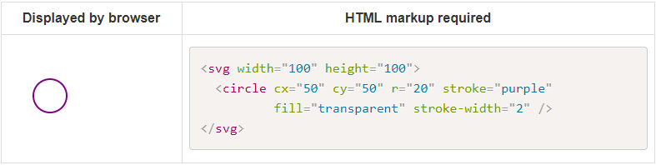
Circle
The <circle> element is used to draw a circle.
Attribute | Meaning
cx | The x position of the center of the circle
cy | The y position of the center of the circle
r | The radius of the circle
Notes:
Cx - The x position of the center of the circle
Cy - The y position of the center of the circle
The cx and cy attributes define the x and y coordinates of the center of the circle. If cx and cy are omitted, the circle's center is set to (0,0)

Slide 7
Rectangle
The <rect> element is used to draw a rectangle.
Attribute | Meaning
x | The x position of the top left corner of the rectangle
y | The y position of the top left corner of the rectangle
width | The width of the rectangle
height | The height of the rectangle
rx | The x radius of the corners of the rectangle
ry | The y radius of the corners of the rectangle

Slide 8
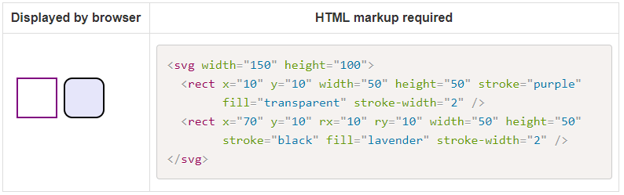
Rectangle
Notes:
Code explanation:
The rx and the ry attributes rounds the corners of the rectangle

Slide 9
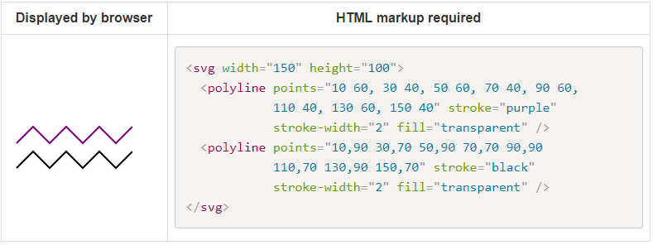
Polyline
The <polyline> element is used to draw a series of straight lines.
﻿﻿﻿﻿﻿﻿﻿﻿﻿﻿﻿﻿﻿﻿﻿﻿﻿﻿﻿﻿﻿﻿﻿﻿﻿
Attribute | Meaning
points | A list of points, each number separated by a space, comma, EOL, or a line feed character. Each point must contain two numbers, an x coordinate and a y coordinate. So the list (0,0), (1,1) and (2,2) could be written: "0 0, 1 1, 2 2" or "0,0 1,1 2,2".

Slide 10
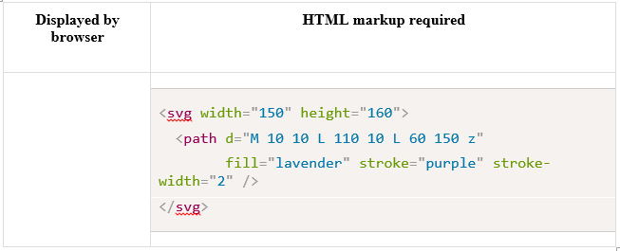
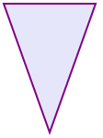
Path
The <path> element is used to draw a path.
This is the most powerful and used element in SVG to draw images as it allows to draw curves, arcs, etc.
Drawing paths in XML is not recommended as this can become very complex, however understanding how path works is useful.
Notes:
Complex shapes composed only of straight lines can be created as polylines.
While polylines and paths can create similar-looking shapes, polylines require a lot of small straight lines to simulate curves and don't scale well to larger sizes.
A good understanding of paths is important when drawing SVGs.
The shape of a path element is defined by one attribute: d (see more in basic shapes). The "d" attribute contains a series of commands and parameters used by those commands.
Each of the commands is instantiated (for example, creating a class, naming and locating it) by a specific letter. For instance, let's move to the x and y coordinates (10, 10). The "Move to" command is called with the letter M. When the parser runs into this letter, it knows you want to move to a point. So, to move to (10,10) you would use the command "M 10 10". After that, the parser begins reading for the next command.

Slide 11
Attribute | Meaning
 | A list of points and other information about how to draw the path. The commands in d can include the following: M = move to L = line to H = horizontal line to V = vertical line to C = curve to S = smooth curve to Q = quadratic Bézier curve T = smooth quadratic Bézier curve to A = elliptical Arc Z = close path Note: All of the commands above can also be expressed with lower letters. Capital letters mean absolutely positioned, lower case letters mean relatively positioned. See the Paths section on MDN for more information.
Notes:
<path d="M 20 20 H 60 V 50 H 20 V 20" stroke="blue" fill="none"/> - For Rect

Slide 12

Adding CSS
SVGs can also be styled using CSS. You can use any svg element as CSS selector.
You can also add classes and ids if this is more convenient.
Displayed by browser | HTML markup required
 | CSS: #myStyledCircle{ fill: lavender; stroke: purple; stroke-width: 10; } HTML: <svg width="100" height="100"> <circle id="myStyledCircle" cx="50" cy="50" r="40" /> </svg>

Slide 13
Important Tags
Applied style can be different based on the shape created
Examples
<line x1="0" y1="0" x2="200" y2="200“>
<circle cx="50" cy="50" r="40“>
<rect x="50" y="20" width="150" height="150“>
Once you define the shape, style can be provided such as fill color, stroke, opacity etc.
<line x1="0" y1="0" x2="200" y2="200“ style="stroke:rgb(255,0,0);stroke-width:2" />
<circle cx="50" cy="50" r="40" stroke="black" stroke-width="3" fill="red" />
<rect x="50" y="20" width="150" height="150" style="fill:blue;stroke:pink;stroke-width:5;fill-opacity:0.1;stroke-opacity:0.9" />

Slide 14
Grouping Elements
The g element can be used to group other svg elements together. This can be very handy when you want to apply transformation or behaviour to a group of SVG elements using either CSS or JavaScript.
In the example below, the grouping is used to translate the whole drawing away from the edge of the SVG by 10 pixels horizontally and vertically, so the drawing don't get truncated.
The CSS also makes use of the grouping, so that when the user hovers over the group with the id group1, the stroke colour of the cicle, ellipses and path turn red, and the ellipses also get a red fill.

Slide 15
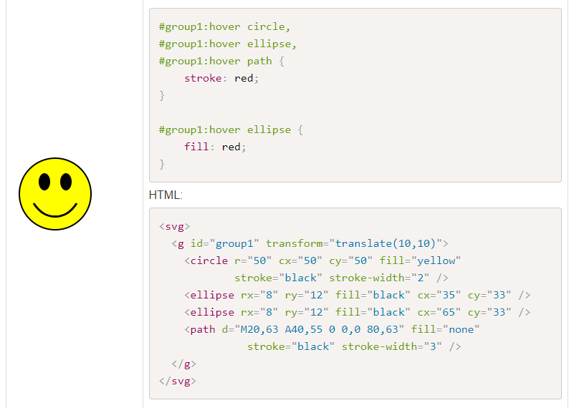
Grouping Example 1

Slide 16
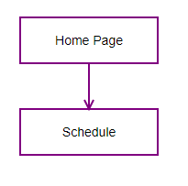
Grouping Example 2

Slide 17
Link to Some of the Students work
https://padlet.com/janani_h/c01znu1g7p636bw3

Slide 18
Practice Exercise - Homework
Draw a frog, a cat or another animal of your choice in SVG using SVG basic shapes.
Add a JavaScript event listener so that something happens when you click on the SVG (e.g. the frog pops up a window saying "ribbit").
Hint: Think of the animal in terms of shapes.

